Slide 1
Patellar Instability
Ala Al-Qudah, MD
MBBS, MRCS, Jordan Board, FRCS(T&O),FRCSEd
Trauma and Orthopaedic Specialist
Orthopaedic Sports Surgery and Arthroscopy Specialist

Slide 2
CASES
16 years old female , Professional Karate player, 3x left knee patellar dislocation while playing sports. Otherwise fit and well. On examination Beighton score 7, Bilateral Genu Valgum, Knee effusion and lateral patellar shift
22 years old , Medical student, Direct blow to the knee . Severe pain , Very limited ROM, + effusion , X-ray – No fractures, MRI- MPFL ? Osteochondral fracture
34 years old female, recurrent patellar dislocation with flexion , otherwise fit and well , TT-TG 25
12 years old boy , miserable malalignment with lateral knee pain and clicking
25 years male ,Professional football player , direct blow to the knee , effusion +3 , X-ray and MRI – MPFL signal

Slide 3
Outline
Definition
Epidemiology
Anatomy
Stabilizers
Risk factors
Clinical Assessment
Investigations
Management

Slide 4
Definition and Epidemiology
Spectrum : subluxation or dislocation of the patella
3% of all knee injuries
5.8 per 100,000 in general population
29 per 100,000 in the 10-17-year-old age group
recurrence rate 15-44% after conservative treatment
Risk Factors :
General : Hyperlaxity, Neuromuscular disease
Local : Ligament injury, Trochlear morphology, Patellar Height, Mechanical Malalignment , Muscular weakness

Slide 5
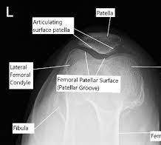
Anatomy
PFJ : Diarthrodial Joint
Patella :
Largest sesamoid bone in the body , Thickest articular cartilage
Two articular facets :medial and lateral- variable size , Wiberg classification
Femur : Trochlear groove between MFC and LFC

Slide 6
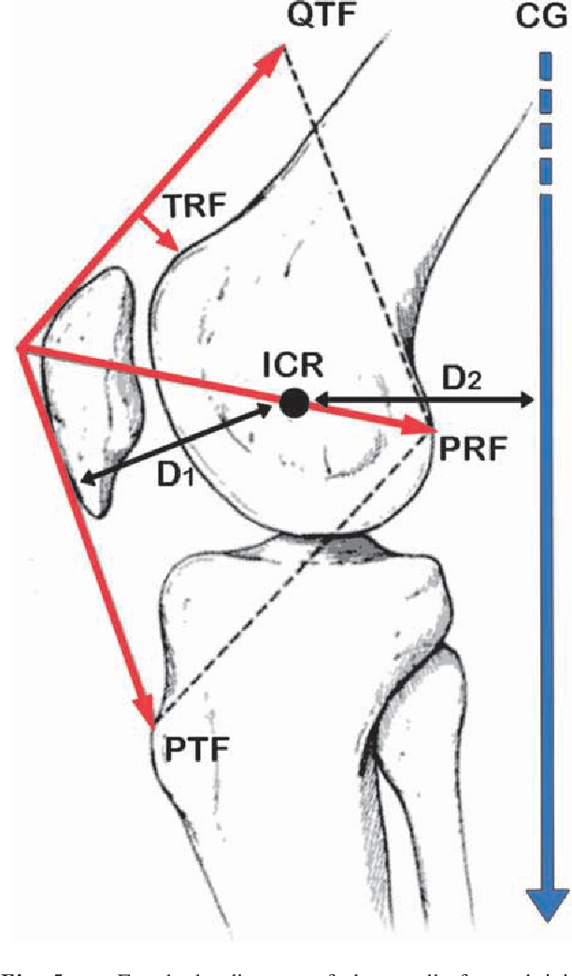
Anatomy: Function of the PFJ
Knee JRF
Patella increase mechanical efficiency of the extensor mechanism by 50%
In vitro and vivo studies : Patellar excision increase force needed by 40% and increases Tibio-femoral JRF by 250%

Slide 7
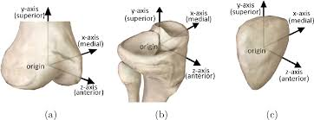
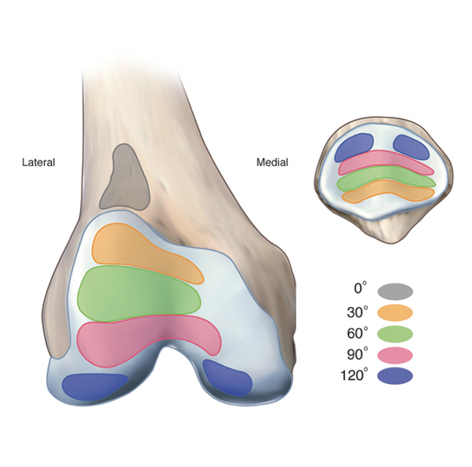
Stability of PFJ
Complex joint motion
Essential to understand the 4D anatomy of the joint
Stability and stabilizers changes with time based on the position of the patella within the groove at a point of time
Patellar contact point and Patellar entry point

Slide 8
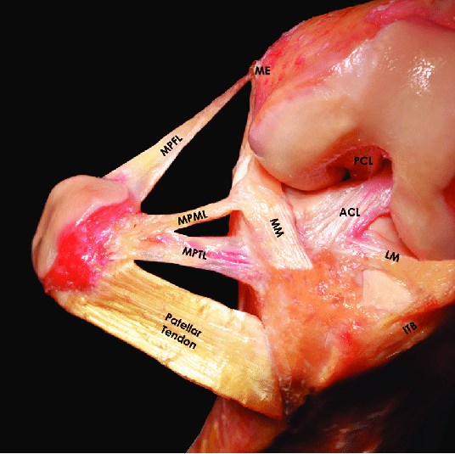
Stability of PFJ
Bone anatomy
Patellar shape( Wiberg et al.)
Trochlear groove morphology and depth(Dejour el al.)
Mechanical and anatomical axis
Q-angle: normal change with flexion and gender: less than 18 in males and 22 in females
Soft tissue stabilizers
Static : MPFL , MPML,MPTL
Dynamic : Quadriceps muscle( VMO)

Slide 9
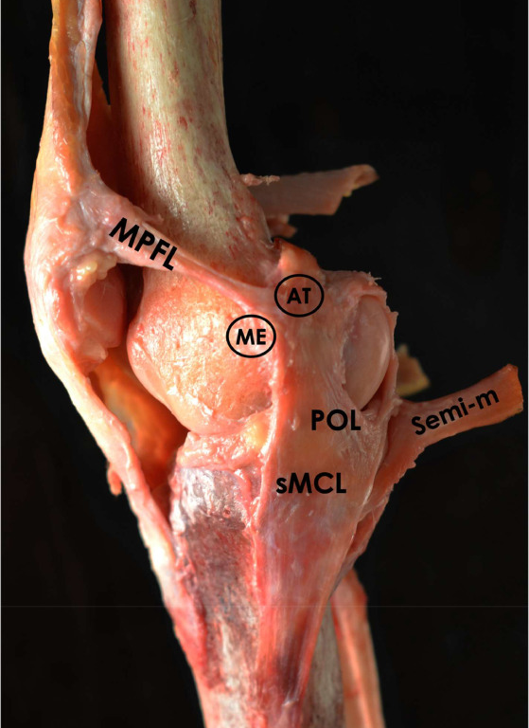
MPFL
Lies in second layers of the knee medially
Fan shape and has two bundles
Femoral attachment : MFC distal to the adductor tubercle and proximal to the superficial MCL fibers posterior to the medial epicondyle
Patellar attachment : Junction of proximal and middle thirds of superomedial patella
Schottle point on true lateral radiograph
Provide restraint to lateral translation from 0-30 flexion
Can with-stand up to 200 N of tension. However, normally works in low tension environment

Slide 10
Clinical Assessment-History
Age of first dislocation
Mechanism
Frequency
Pain, tenderness
Gait
Hypermobility and other joints
PMHx, Surgical Hx
Treatment
Family Hx
Risk Factors

Slide 11
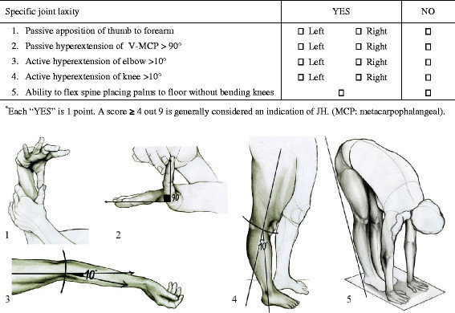
Clinical Assessment - Examination
Look , Feel , Move
Standing
Gait
Signs of hypermobility – Marfan, ED syndrome, Beighton score
Lower limb axis- Genu valgum
Rotational profile : Foot progression angle and patellar position
Always examine the hands and proper neurological assessment

Slide 12
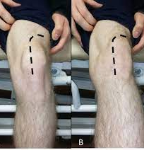
Clinical Assessment - Examination
Sitting
J-signs
ROM

Slide 13
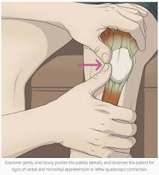
Clinical Assessment - Examination
Supine
Effusion – Grading , Patellar Tap, Ballottement, Fluid thrill
Palpation –Tenderness, Crepitus
Active and Passive ROM
Patellar Translation , Quadrant test,End- point , Pain
Patellar tilt
Patellar height
Quadriceps , VMO , Patellar and Quadriceps Tendons
Apprehension test
Knee joint
Neurovascular exam
Always compare

Slide 14
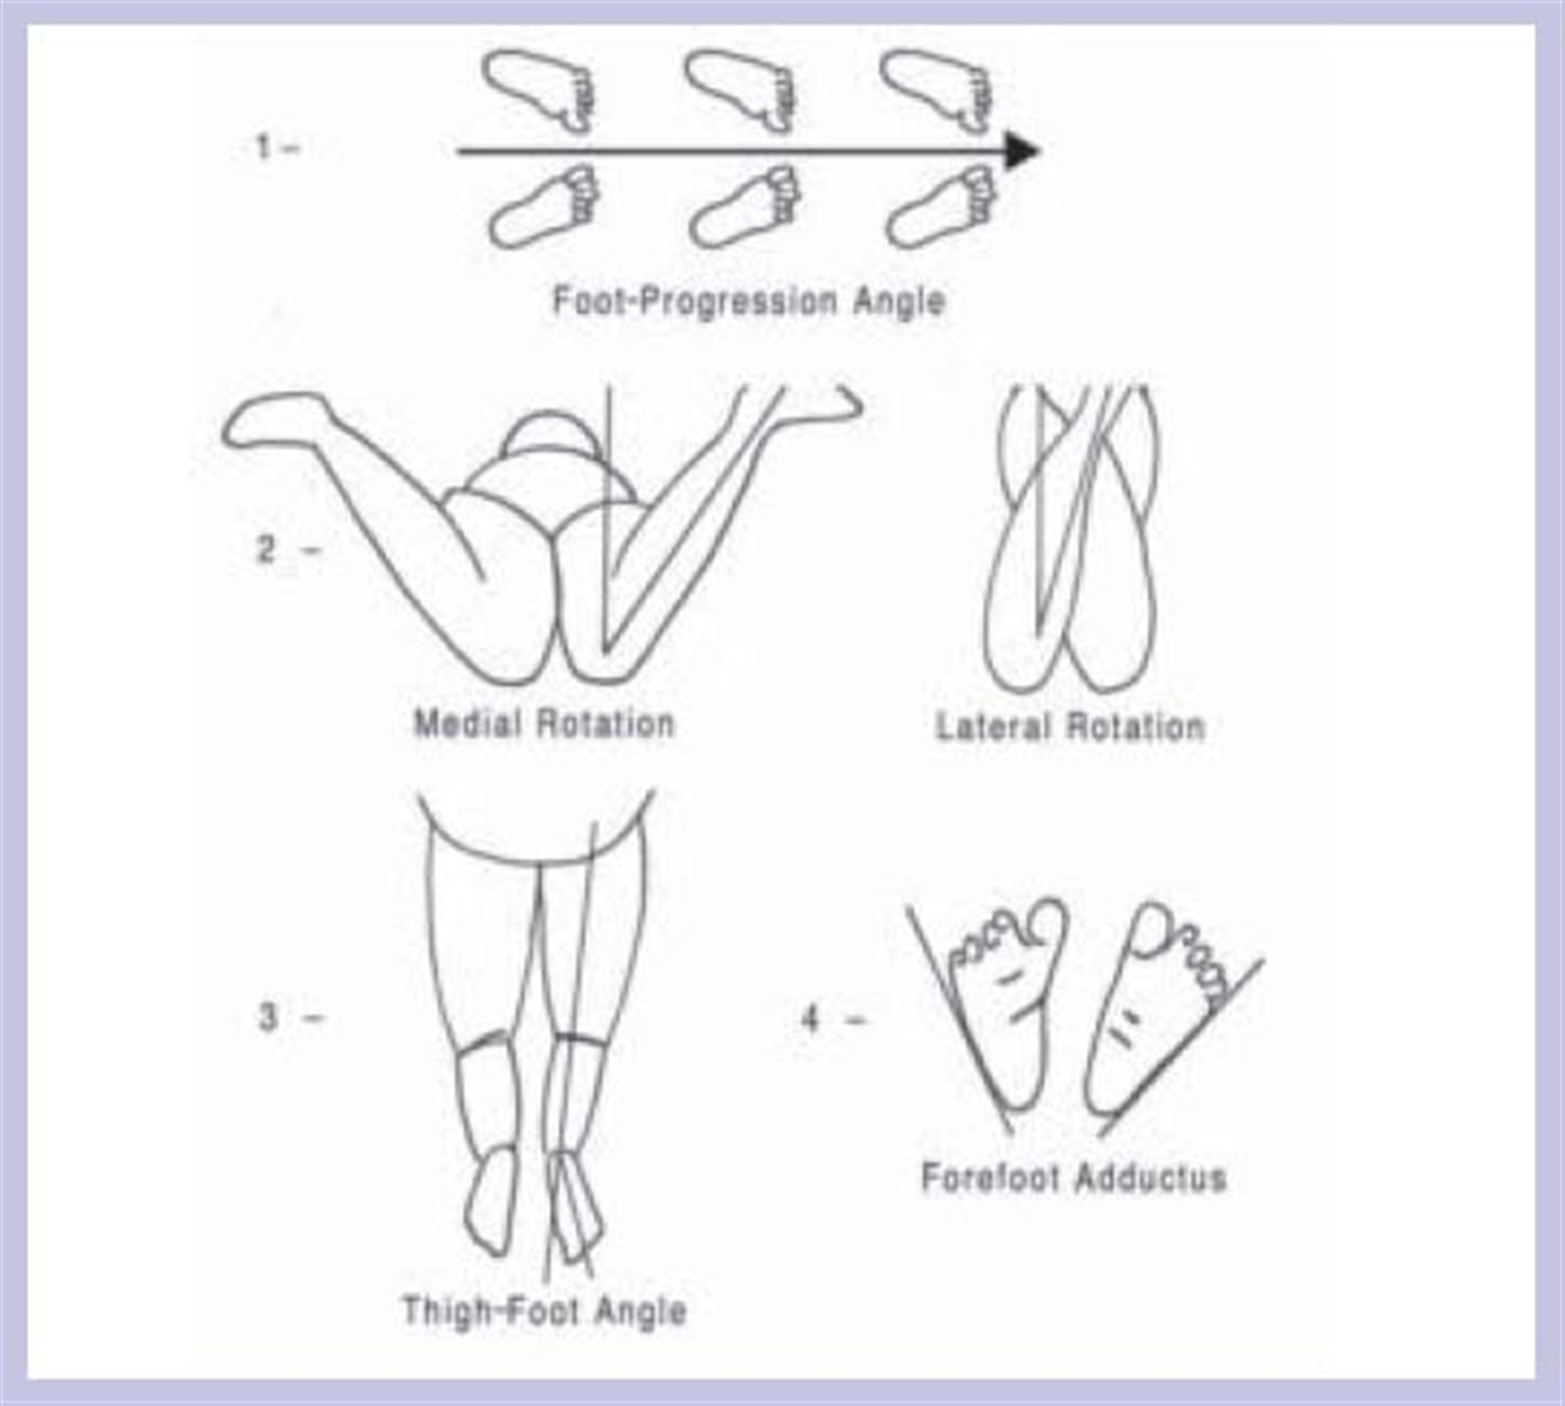
Clinical Assessment - Examination
Prone :
Rotational profile mainly femoral version

Slide 15
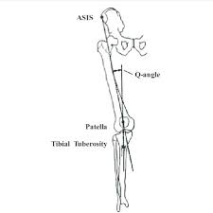
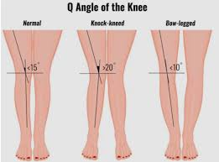
Radiology- AP Radiographs
Standing Long lower limb measurement radiographs
Q-angle
Lower Limb axis

Slide 16
Radiology – Lateral radiographs
Dejour classification is based on true lateral radiographs

Slide 17
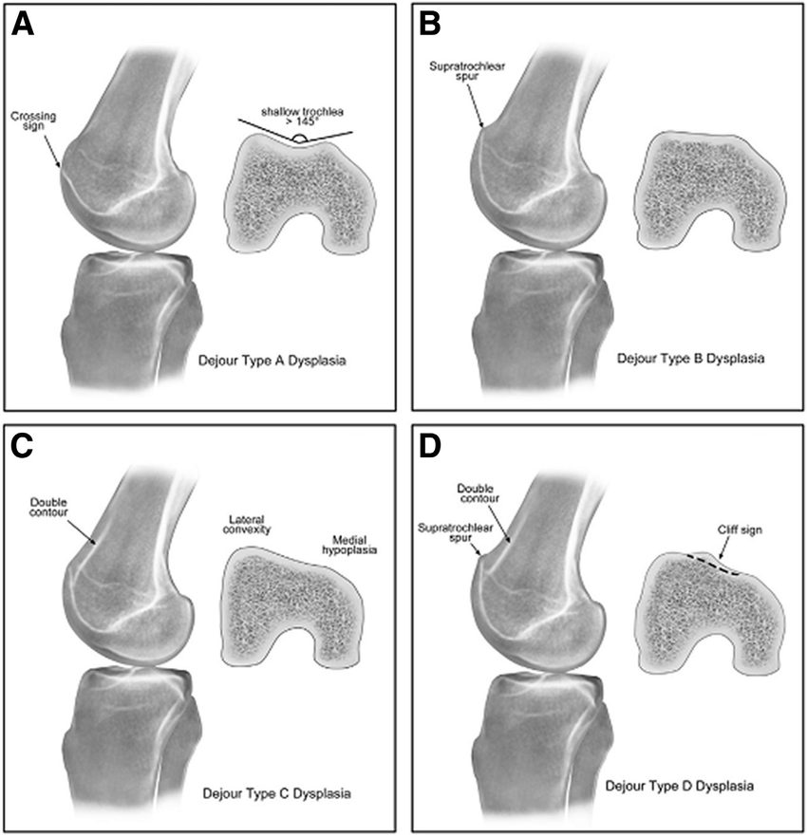
Radiology – Lateral radiographs
Dejour classification:
Crossing Sign
Double contour
Trochlear Spur

Slide 18
Radiology – Lateral radiographs
Dejour classification:
Type A: crossing sign, normal facet geometry but shallow trochlea
Type B: crossing sign, trochlear spur on lateral radiograph and flat trochlear groove on cross-sectional imaging
Type C: crossing sign and double contour on lateral radiograph with medial facet hypoplasia and lateral facet convexity
Type D: crossing sign, trochlear spur and double contour on the lateral radiograph and a cliff-like pattern between the medial and lateral facets

Slide 19
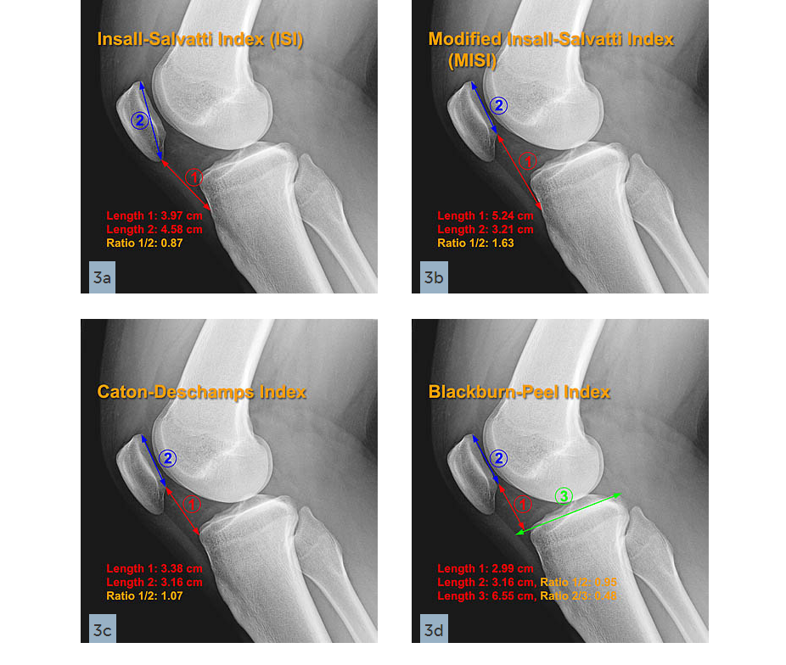
Radiology – Lateral radiographs
Patellar Height
Can be measured on MRI scan too
We use Insall-Salvati and Caton-Deschamps index
Less variation with the Caton-Deschamps index

Slide 20
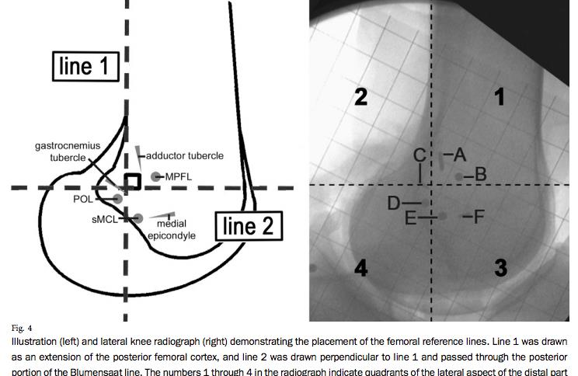
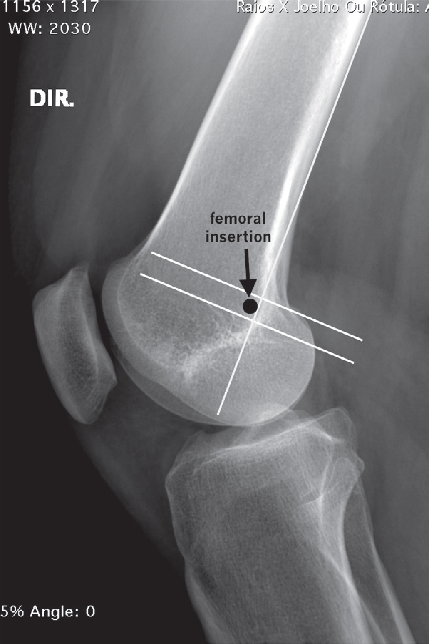
Radiology – Lateral radiographs
Schottle point

Slide 21
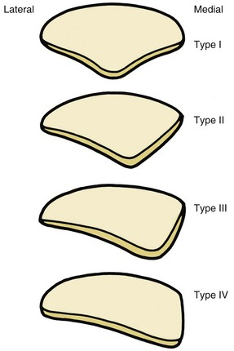
Radiology – Merchant view
Position of the patella during flexion may affect interpretation – Usually instability begins at the onset of flexion
Lateral Patellar tilt- Variable between different studies – up to 8 is accepted
Sulcus angle- Normal 135±10º
Congruence angle (-6 degrees)
Lateral Patellofemoral angle –Normal >11
Patellar shape and morphology- Weiberg classification

Slide 22
Radiology – CT and MRI
CT- Osteochondral fractures ,Loose bodies, TT-TG distance, Trochlear groove, Patellar morphology , 3D reconstruction
MRI
Cartilage
Osteochondral fractures
TT-TG distance
TT- PCL distance (Seitlinger et al.)
MPFL
Bedierat classification and cartilage overlap(Biedert et al.)

Slide 23
Patellar Instability – Management aims
1
2
3
Restore stability and Tracking
Treat underlying osteochondral damage
Prevent development of OA

Slide 24
Patellar Instability – Management guidlines
Complex pathology with lack of high-quality evidence
Multifactorial pathology
The American Society for Sports Medicine and the Patellofemoral Foundation guidelines – Expert opinion and lack of high-quality evidence.
"menu à la carte" algorithm - Dejour et al.
BASK and BOAST Consensus guidelines:Robust Systematic review of current literature

Slide 25
Patellar Instability – Algorithm

Slide 26
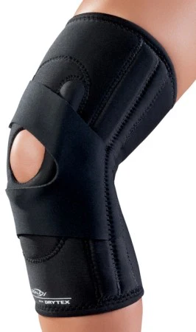
Patellar instability – Conservative treatment
First time dislocation
Reducible with no Osteochondral fractures
Avoid prolonged immobilization due to high risk of stiffness
Patellar Brace- controlled motion
Arthrocentesis for pain
Dynamic stabilizers strengthening – Close chain , VMO, Quadriceps strengthening, Core body strengthening, ITB stretching
High Re-dislocation rate especially with chronic MPFL injury

Slide 27
Patellar instability- Surgical Treatment
MDT approach- Specialist Knee surgeon , Physiotherapy, Occupational therapist
Arthroscopy
Soft tissue reconstruction – MPFL
Bony procedures – TT transfer, Trochleoplasty and Trochlear groove deepening
Osteotomies around the knee to restore Q-angle and rotation
Tailored according to underlying pathology
Lateral release- May increase lateral and medial instability

Slide 28
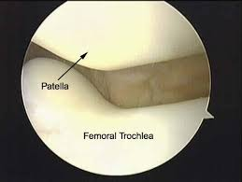
Surgical treatment - Arthroscopy
Removal of loose bodies or osteochondral fragments
Real-time visualization of patellar tracking- Fluid inflation may alter normal tracking
Assess for OA
Debridement of the trochlear spur

Slide 29
Surgical treatment - MPFL reconstruction
Autograft – Gracilis , Semi-tendonitis – No enough evidence which one is better.
Allograft
Double limb Autograft has better outcome -Weinberger et al
Anatomical reconstruction under Image guidance –Shottle point
Onlay or inlay fixation
Different fixation methods , screws , endobuttons
Severe trochlear dysplasia is the most predictable factor for failure-Kita, Keisuke et al

Slide 30
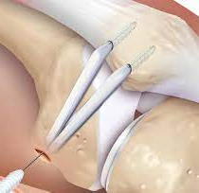
Surgical Technique - MPFL reconstruction
Anatomic Double bundle autograft – Semitendinosus
General ,Spinal or regional anesthesia
Important landmarks – Borders of the patella , Medial Epicondyle, TT, Schottle point on II, Joint line
Harvest and prepare the Semi-T through standard approach
Two Incisions for MPFL reconstruction
Preparation of the Patellar and femoral tunnels

Slide 31
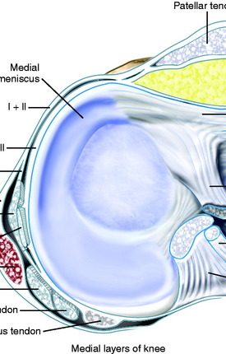
Surgical Technique - MPFL reconstruction
Essential to understand the medial layers of the knee
Graft passed in the second layer between the capsule and retinaculum
Identify the shottle point : Proximal and posterior to the medial epicondyle in the sulcus between the Medial Epicondyle and adductor tubercle
Always use Image intensifier
Methods for fixation : Interference screws , Anchors , endobuttons
Avoid tight graft – may cause anterior knee pain or limit ROM

Slide 32
Surgical Technique - MPFL reconstruction
Post operative rehabilitation :
Gradual ROM in adjustable knee brace 0-90

Slide 33
Trochleoplasty
Indication :Recurrent Patellar instability with severe Trochlear dysplasia B or D and evidence of maltracking
Contraindication : OA, Open physis , pain but no instability
Aims to decrease JRF and improve tracking by deepening the groove and improve the TT-TG distance
Open or Arthroscopic

Slide 34
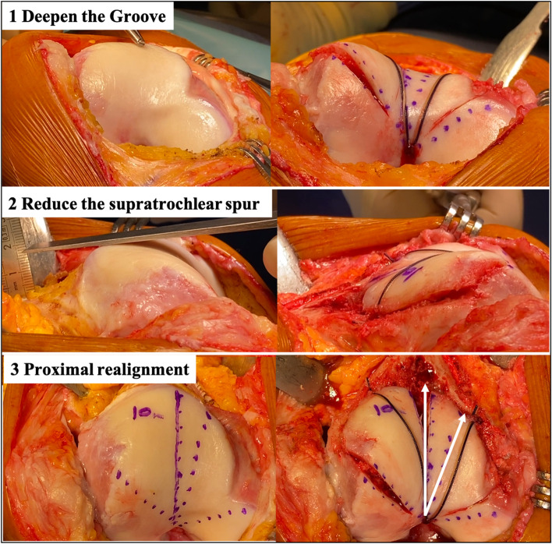
Trochleoplasty- Open Technique
Dejour et al. Described the open technique for trochleoplasty
Three main goals
Deepening of the groove
Reduce the Spur
Proximal realignment
Subchondral approach to preserve the cartilage

Slide 35
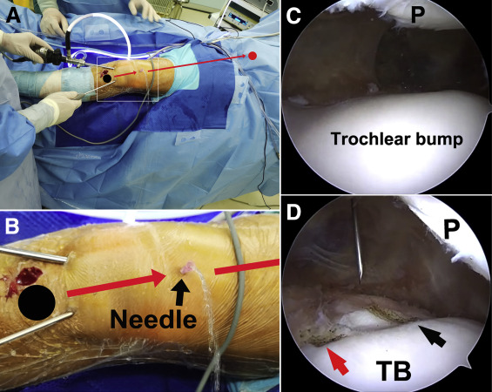
Arthroscopic Trochleoplasty
Minimal invasive -Four portals
Cartilage flaps
Debride the spur and deepening the tunnel
Fixation of the cartilage flap –Anchors

Slide 36
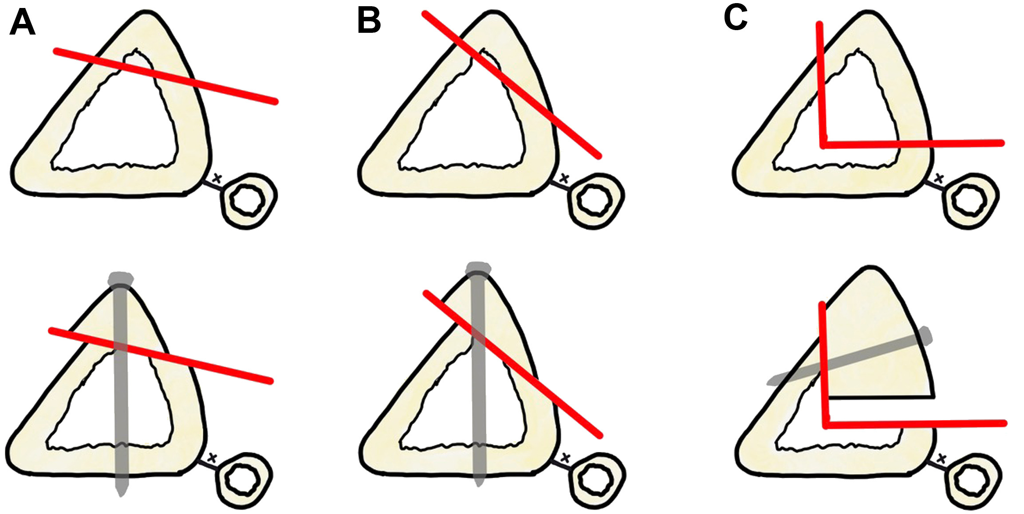
Tibial Tuberosity Transfer-TTT
Indications : Recurrent patellar instability with failed conservative treatment, Anterior Knee pain , Abnormal patellar height , TT-TG distance >20mm
Need careful interpretation of the TT-TG distance in the context of lower limb rotational abnormalities.
Preoperative planning : Osteotomy plane will determine the final PFJ biomechanics
Types :
Anteromedialization – Fulkerson
Anteriorization – Maquet , Fulkerson
Medialization : Elmslie-Trillat procedure
Distalization

Slide 37
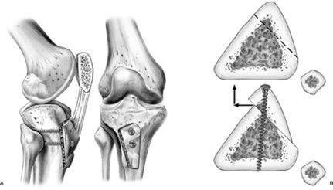
Tibial Tuberosity Transfer-AMZ osteotomy
Approach – Anterior midline but can be modified to address other pathologies
Exposure : Full thickness skin flaps, Tourniquet improves exposure
Osteotomy :
Plane of osteotomy will determine the amount of anteriorization and medialization
We aim for distally tappred 7-10 cm pedicale
Fixation : We use lag screws with interfragmentary compression – Usually 2-3 screws

Slide 38
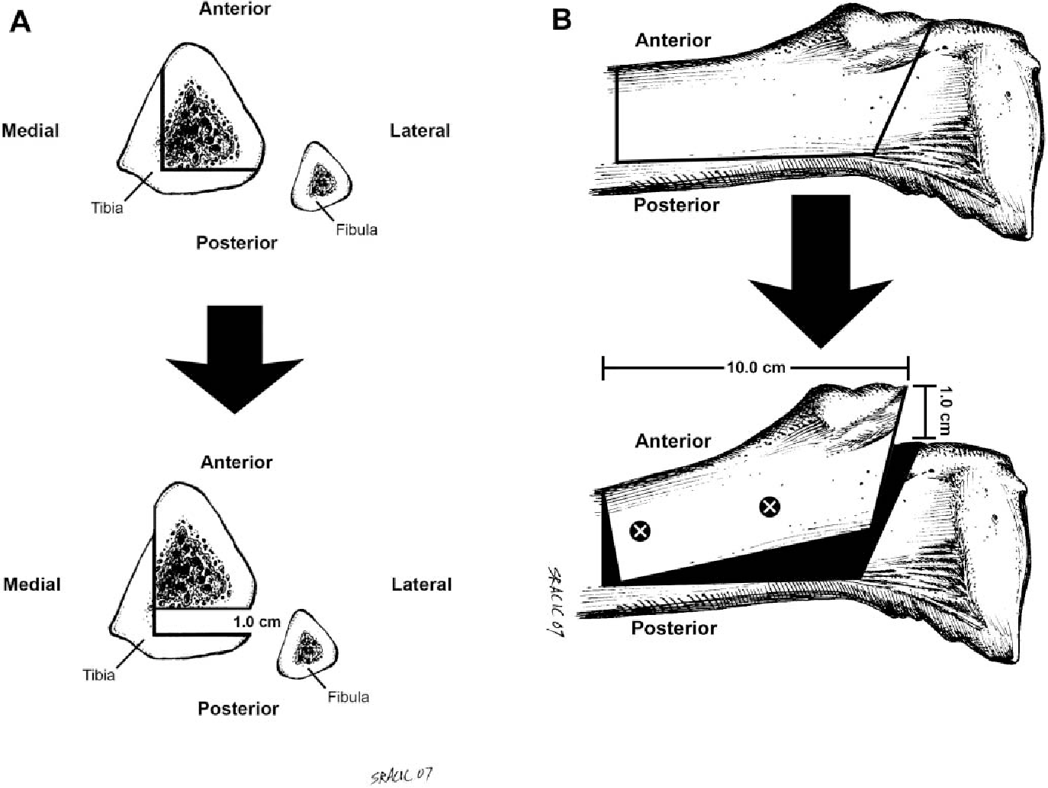
Tibial Tuberosity Anteriorization
Maquet Technique- Requires structural bone graft to support the tuberosity- high complication rate
Fulkerson : Based the AMZ osteotomy . More posterior and vertical cut will allow anteriorization without the need of bone graft

Slide 39
TTT- Post-operative rehabilitation
Non weight bearing with hinged knee brace locked in extension
Early Quadriceps exercise
Gradual weight bearing at 6 weeks
Gradual increase of ROM after swelling and pain allows

Slide 40
Is there a golden option?
MPFL is the main stabilizer for lateral translation, and it is injured in almost all lateral patellar dislocations-Duthon Et al.
Recurrent after conservative treatment with MPFL injury is up to 44 %
PFJ Dislocation after MPFL reconstruction alone is very low - <5%
Succes rate after MPFL and TTT - 96% -Ebied AM
There is no gold standard treatment and treatment should be tailored for each patient.

Slide 41
THANK YOU

